Slide 1
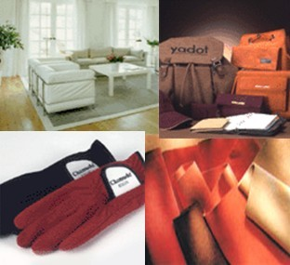
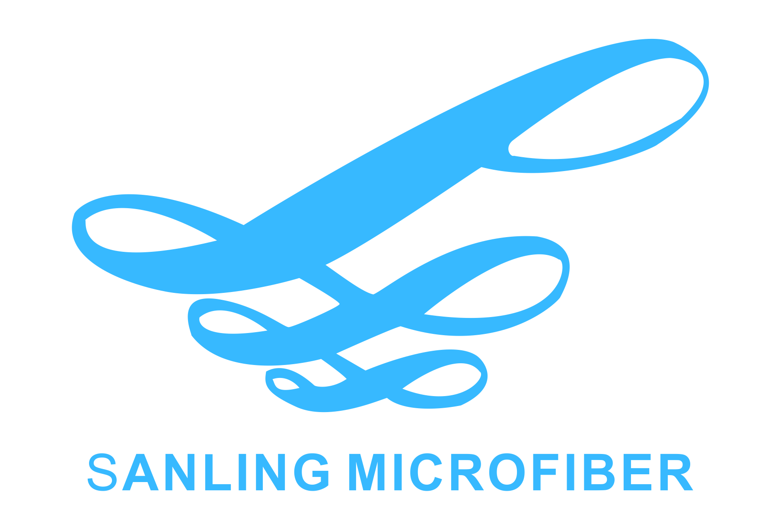
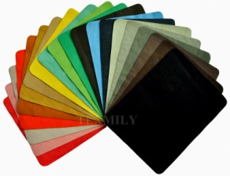
Think Green Think Future
SANLING MICROFIBER

Slide 2
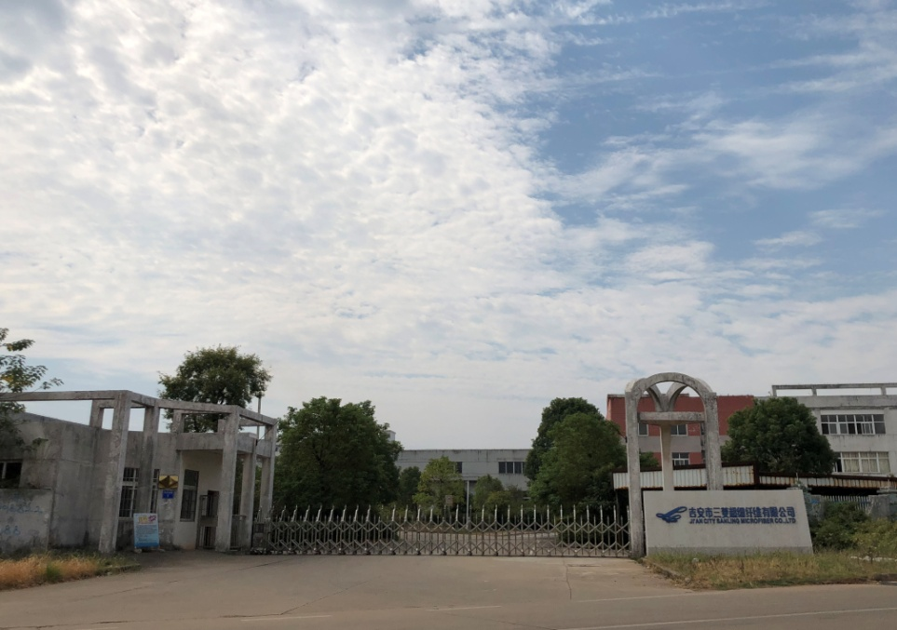
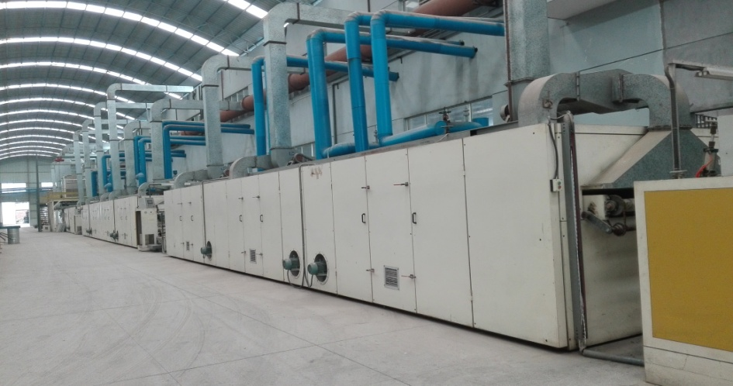
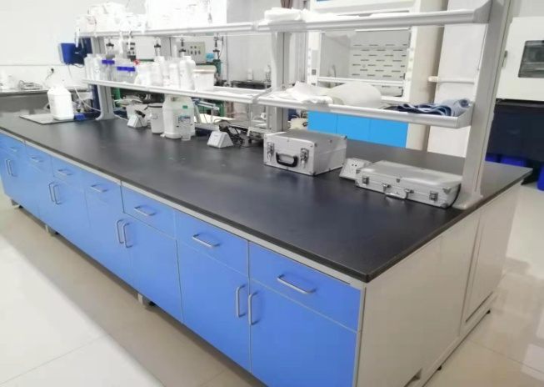
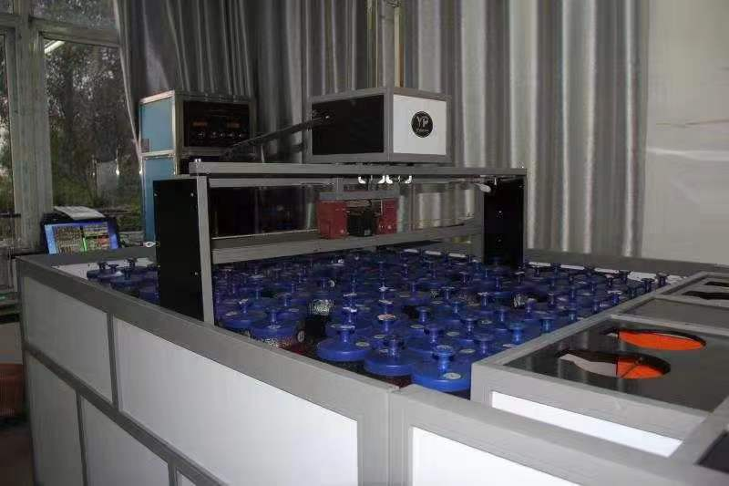
WELCOME TO SANLING: YOUR RELIABLE MICROFIBER MATERIAL PARTNER

Slide 3
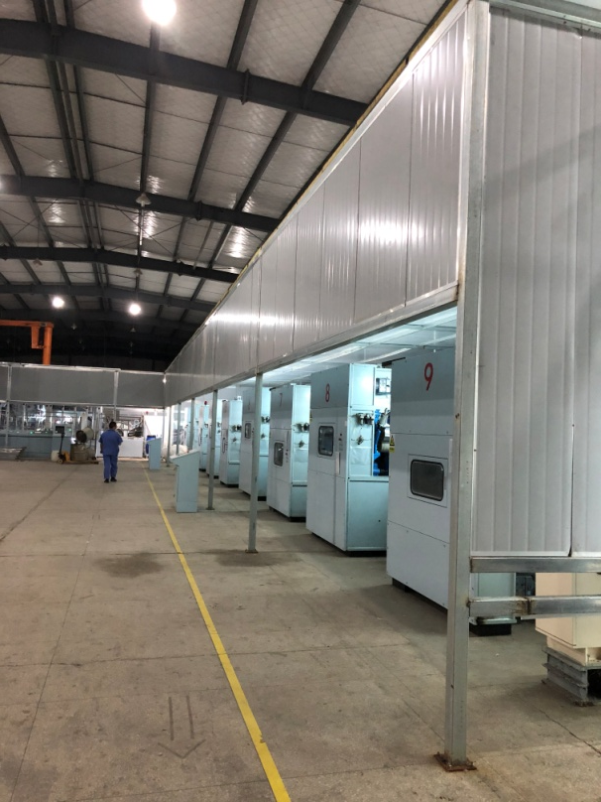
Since established in 2010, SANLING has been one of the fastest developing manufacturers of microfiber leather in China. Invested more than USD12, 000, 000, with 104 employees, possessing talented engineers and management team, SANLING devoted itself to serve customers both from international and domestic market with it's sincerity. Over the past few years SANLING has invested USD800,000-USD1,000,000 yearly in R&D for solvent free material, and started mass production of solvent free microfiber suede since 2018. Thanks to the management direction of "Make the best quality and offer the newest technology microfiber leather to customers", SANLING has gained unprecedented growth and expansion throughout this tough economic time. Not only dedicating resource to production line, but also in environment protection technology, SANLING is trying to do the best in the responsibilities of society and environment improvement.
We have the certificates issued by prestigious international organizations.
Quality Management system:
UNI EN ISO 9001:2008
Environmental Management system:
UNI EN ISO 14000:2004

Slide 4
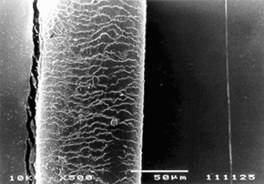
WHY SANLING MICROFIBER
The staple fiber consists of polyamide as island and easy soluble co-polyester as sea component.
So, we call this a sea & island type composition fiber.
After dissolving the sea component by caustic soda solution, fiber can be fibrillated to 0.06D, which is one tenth of a percent of human hair.
HAIR
ULTRA-FINE MICROFIBER

Slide 5
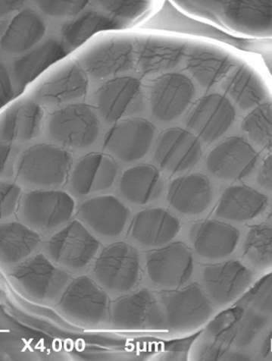
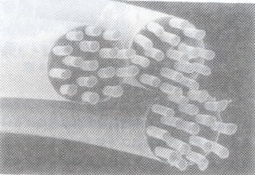
SOLVENT FREE TECHNOLOGY
STAPLE FIBER
NaOH sea-component dissolved solution. TOLUENE FREE
NONWOVEN SHEET
SOLVENT FREE PU TREATMENT
SOLVENT FREE FIBRILLATION
DYEING &AFTER TREATMENT
PACKING
PET DUST RECYCLE
WASTE WATER PURIFY
WATERBORNE COATING FILLER

Slide 6
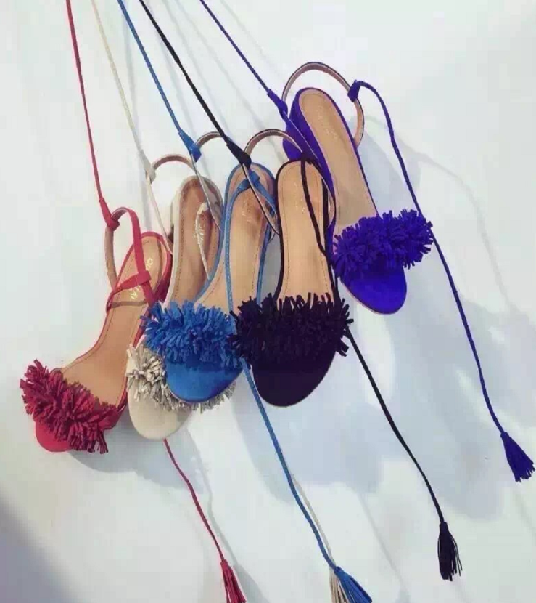
ENVIRONMENT PROTECTION
We are doing our best in environment protection:
By using waterborne PU to ensure 0 DMF during PU process and DMF FREE in our microfiber leather.
By using NaOH solution to dissolve PET from each staple fiber to avoid any solvent solution such as toluene in production.
By recycling and purifying PET for reusing as filler for the waterborne coating.
By purifying waste water after NaOH treatment and dyeing process to ease the burden of the environment.

Slide 7
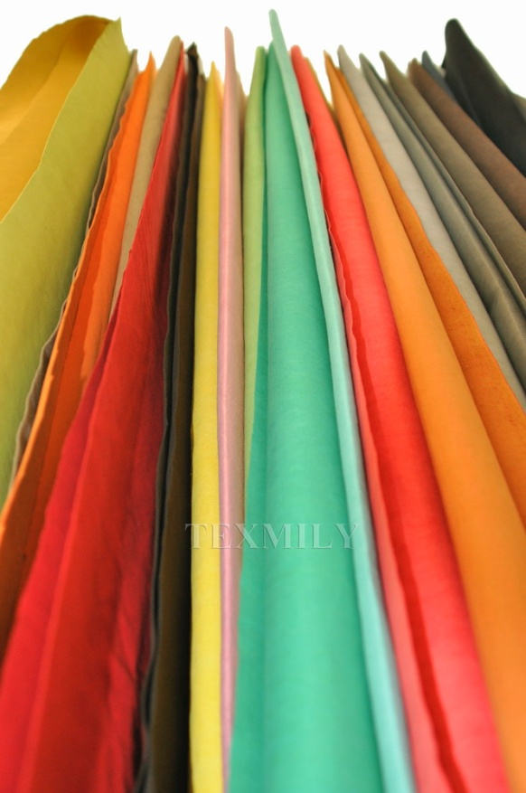
Contact us:
Ji'an City Sanling Microfiber Co.,Ltd. Add: No.1 Huandao Rd.(South), Jinggangshan National Economic & Technology Industry Zone, Ji'an City， Jiangxi Province, P.R.China 343100 Tel: +86 796 8411333 Fax: +86 796 8440777 http://www.sanlingmicrofiber.com/
Email: info@sanlingmicrofiber.com

